Slide 1

Batch Data Analytics
Batch data analytics tool is an Enterprise grade web application based on Python Django framework designed to facilitate in depth batch data analysis and reporting

Slide 2
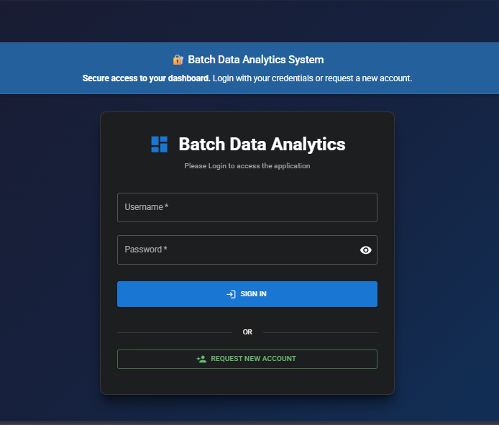
Login module
Login Module designed for seamless Application access and supports LDAP integration and able to create new user account requests

Slide 3
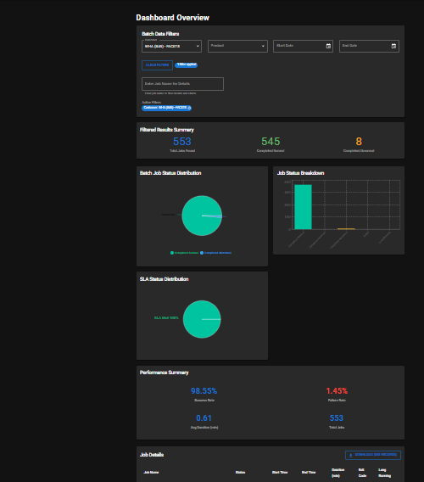
DasHBOARD MODULE
Dashboard module is a centralized command center which provides Realtime metrics Customer Performance Interactive filters and export capabilities

Slide 4
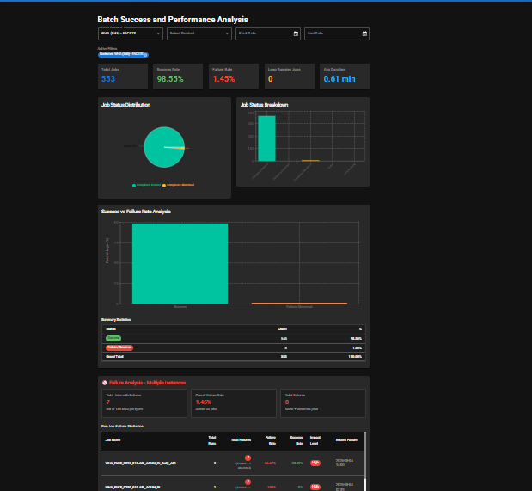
Batch Success and Performance Module
Batch Success and Performance is an intelligent module which provides intelligent job monitoring and analytics performance insights, Customer-Specific views, Status Categorization, Long running job detection and trend analysis

Slide 5
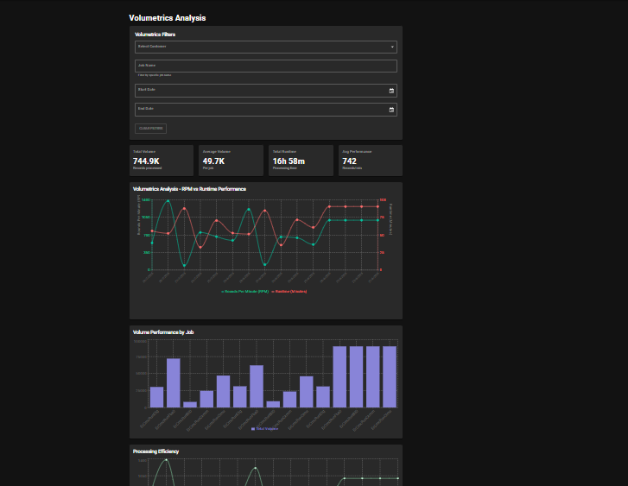
Volumetric Analysis
This module facilitates job wise volume tracking for all customers also provides it also provides peak volume and historical trends data

Slide 6
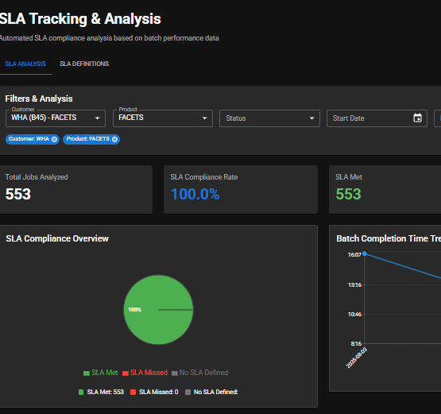
SLA Tracking and analysis
SLA tracking and analysis module provides real time tracking and displays compliance data per customer also provides Time-based monitoring functionality and customer SLA views.

Slide 7
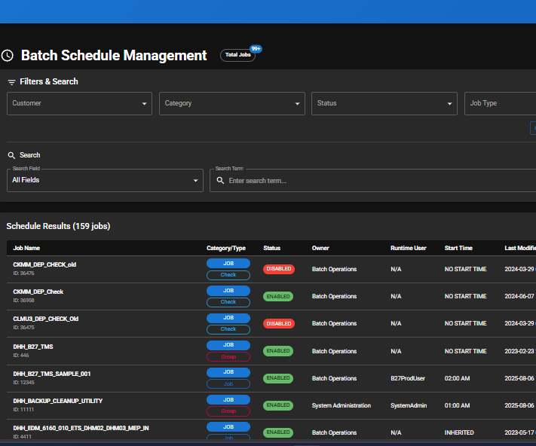
Batch Schedule Module
Batch schedule module provides comprehensive scheduling report creation and supports Tidal scheduler integration User can review batch schedule details and download details in CSV format as per requirement

Slide 8
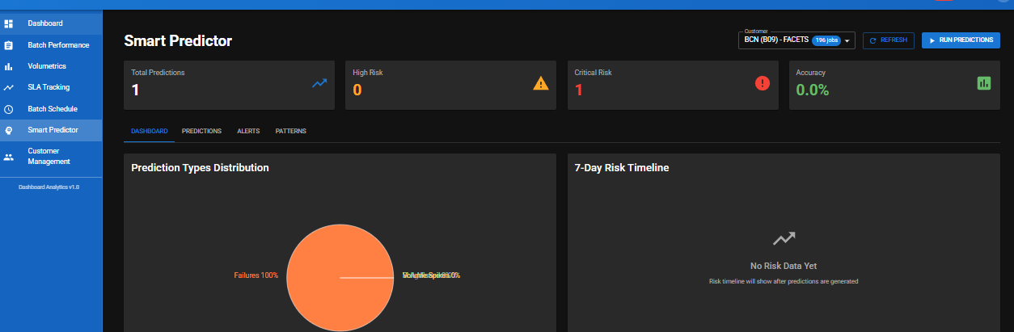
Smart Predictor
Smart predictor module uses historical pattern analysis for job failures and long runners to identify performance bottlenecks it has

Slide 9
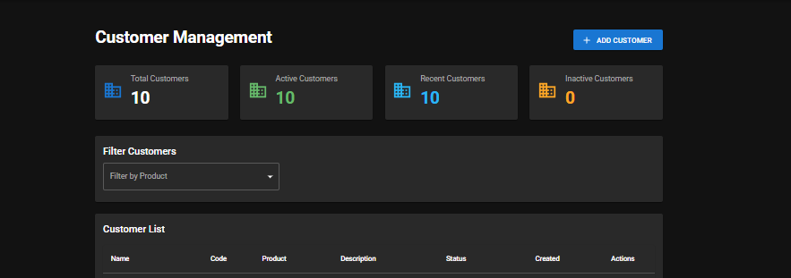
Customer Management MODULE
This module is used for adding/removing Customers as per requirement and upload new data customer data as per user requirement

Slide 10
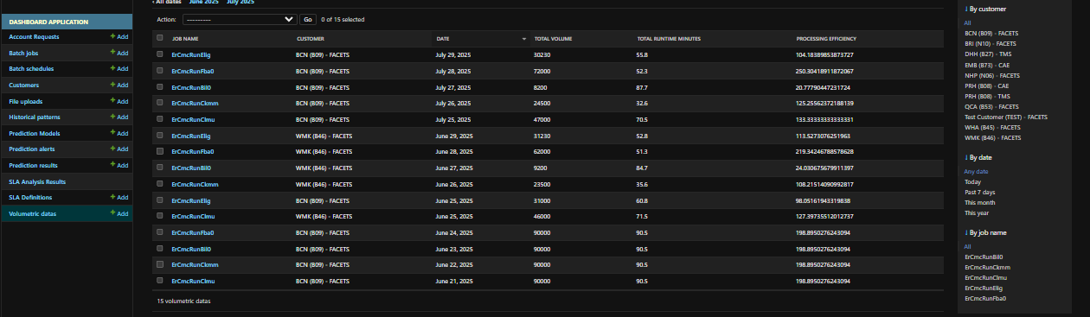
Django Admin Module
This module is controlled by admin to perform advanced tasks like CRUD operations and user authentication management.

